Slide 1
Google Case Study
IT332 – Distributed Systems

Slide 2
Google Company
Google, a US-based corporation, was born out of a research project at Stanford with the company launched in 1998.
Offers Internet search and broader web applications
Earns revenue largely from advertising associated with such services.

Slide 3
Google Distributed System: Design Strategy
Google has diversified and as well as providing a search engine is now a major player in cloud computing.
88 billion queries a month by the end of 2010. The user can expect query result in 0.2 seconds.
Good performance in terms of scalability, reliability, performance and openness.

Slide 4
Google Search Engine
Consist of a set of services
Crawling:
To locate and retrieve the contents of the web and pass the content onto the indexing subsystem. Performed by a software called Googlebot.
Indexing:
Produce an index for the contents of the web that is similar to an index at the back of a book, but on a much larger scale.
Ranking:
Relevance of the retrieved links. Ranking algorithm is called PageRank, a page will be viewed as important if it is linked to by a large number of other pages.

Slide 5
Google as a cloud provider
A set of Internet-based application, storage and computing services sufficient to support most user's needs,
Software as a service:
offering application-level software over the Internet as web application.
Ex: Gmail, Google Docs, Google Talk and Google Calendar. Aims to replace traditional office suites. ( more examples in the following table)
Platform as a service:
offering distributed system APIs and services across the Internet, with these APIs used to support the development and hosting of web applications.
Google App Engine

Slide 6
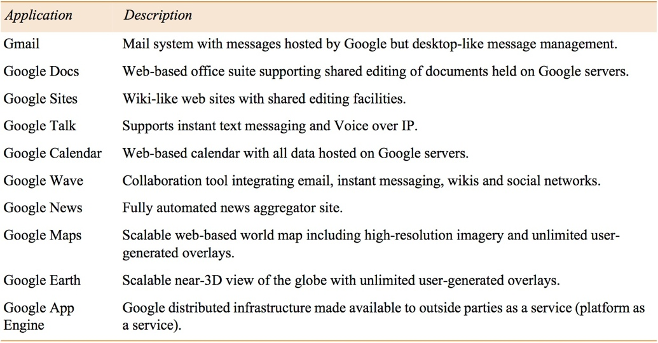
Example Google applications

Slide 7
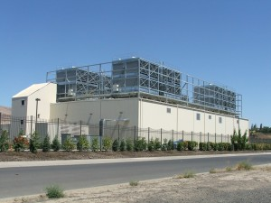

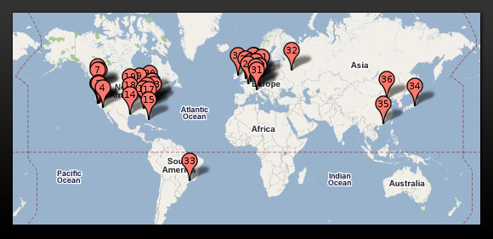
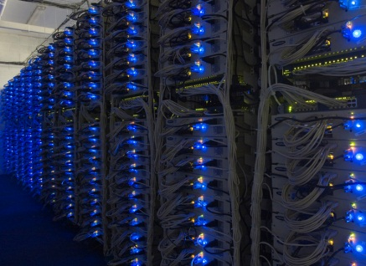
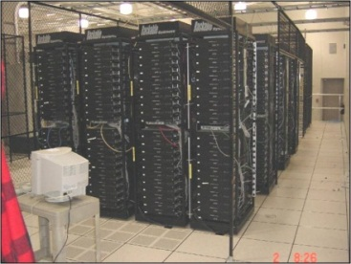
Physical Model of a Google DS
Commodity PC
Data Center
Cluster
Approx 30 racks (around 2400 PCs)
2 high-bandwidth switches (each rack connected to both the switches for redundancy)
Placement and replication generally done at cluster level
Rack
Approx 40 to 80 PCs
One Ethernet switch (Internal=100Mbps, external = 1Gbps)

Slide 8
Key Requirements
Scalability: i). Deal with more data ii) deal with more queries and iii) seeking better results
Reliability: There is a need to provide 24/7 availability. Google offers 99.9% service level agreement to paying customers of Google Apps covering Gmail, Google Calendar, Google Docs, Google sites and Google Talk.
Performance: Low latency of user interaction. Achieving the throughput to respond to all incoming requests while dealing with very large datasets over network.
Openness: Core services and applications should be open to allow innovation and new applications.

Slide 9
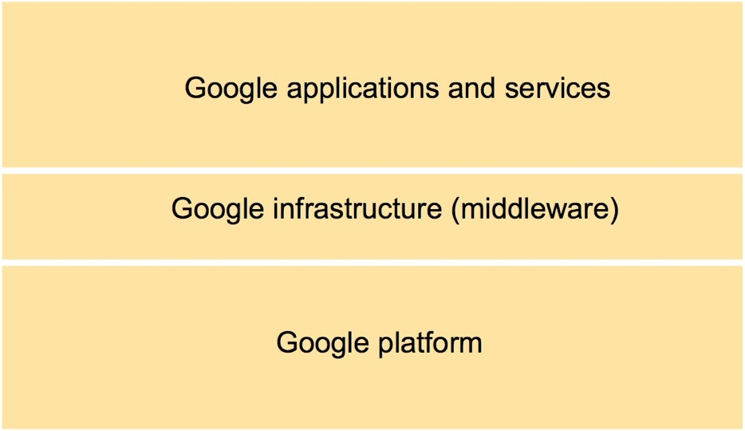
The overall Google systems architecture

Slide 10
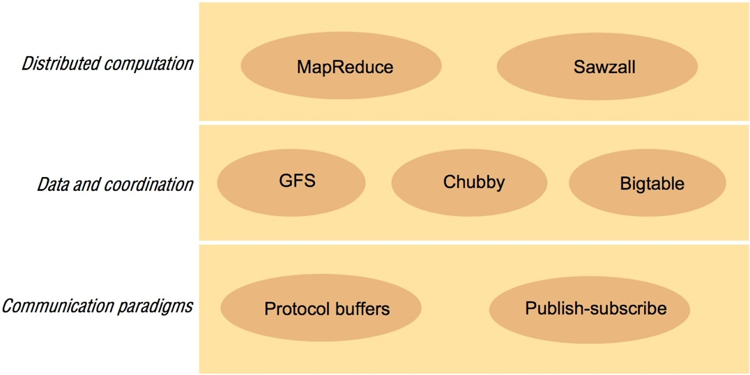
Google infrastructure

Slide 11
Google Infrastructure
The underlying communication paradigms, including services for both remote invocation and indirect communication.
The protocol buffers offers a common serialization format including the serialization of requests and replies in remote invocation.
The publish-subscribe supports the efficient dissemination of events to large numbers of subscribers.
Data and coordination services providing unstructured and semi-structured abstractions for the storage of data coupled with services to support access to the data.
GFS offers a distributed file system optimized for Google application and services like large file storage.
Chubby supports coordination services and the ability to store small volumes of data
BigTable provides a distributed database offering access to semi-structure data.
Distributed computation services providing means for carrying out parallel and distributed computation over the physical infrastructure.
MapReduce supports distributed computation over potentially very large datasets for example stored in Bigtable.
Sawzall provides a higher-level language for the execution of such distributed computation.

Slide 12
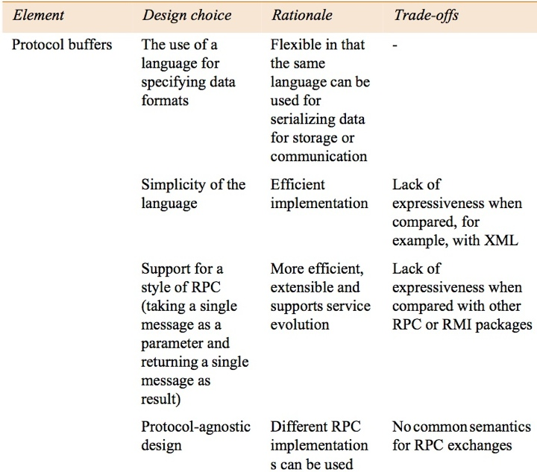
Summary of design choices related to communication paradigms - part 1

Slide 13
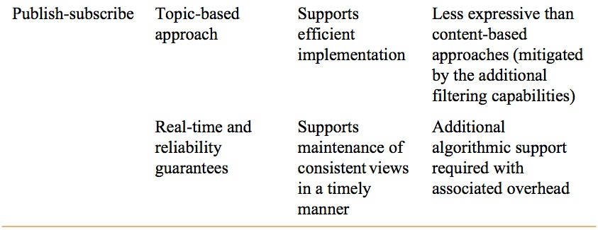
Summary of design choices related to communication paradigms - part 2

Slide 14
Google File System
Companies like Amazon and Google offer services to Web clients resulting in reads and updates to a massive number of files distributed across literally tens of thousands of computers
To address this problem, Google, has developed its own Google File System (GFS)
The GFS offers similar abstractions but is specialized for storage and access to very large quantities of data (not huge number of files but each file is massive 100Mega or 1Giga)
And sequential reads and sequential write as opposed to random reads and

Slide 15
GFS Architecture
File name, chunk index
GFS client
Master
Contact address
Instructions
Chunk-server state
Chunk Id, range
Chunk Server
Chunk Server
Chunk Server
Chunk data
Linux File System
Linux File System
Linux File System

Slide 16
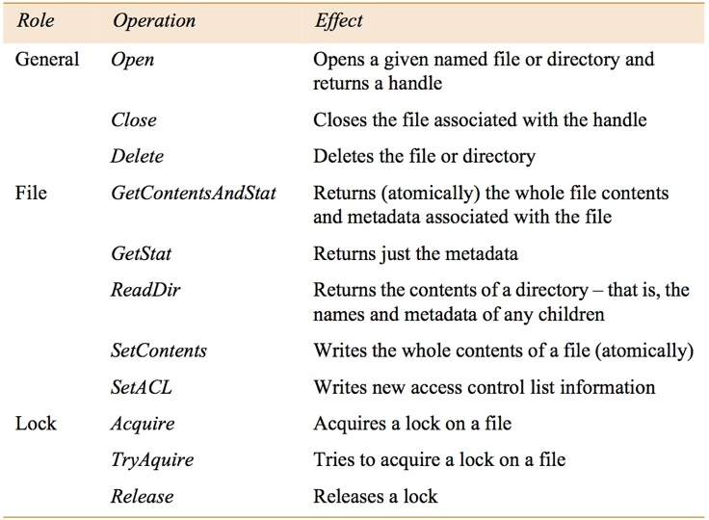
Chubby API
Four distinct capabilities:
Distribute locks to synchronize distributed activities in a large-scale asynchronous environment.
File system offering reliable storage of small files complementing the service offered by GFS.
Support the election of a primary in a set of replicas.
Used as a name service within Google.

Slide 17
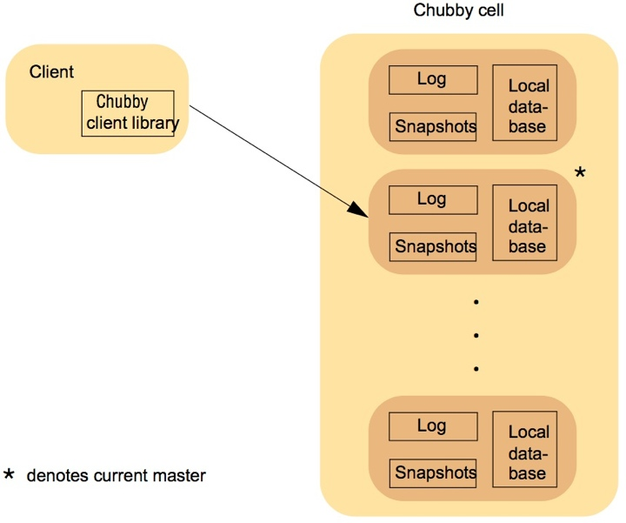
Overall architecture of Chubby

Slide 18
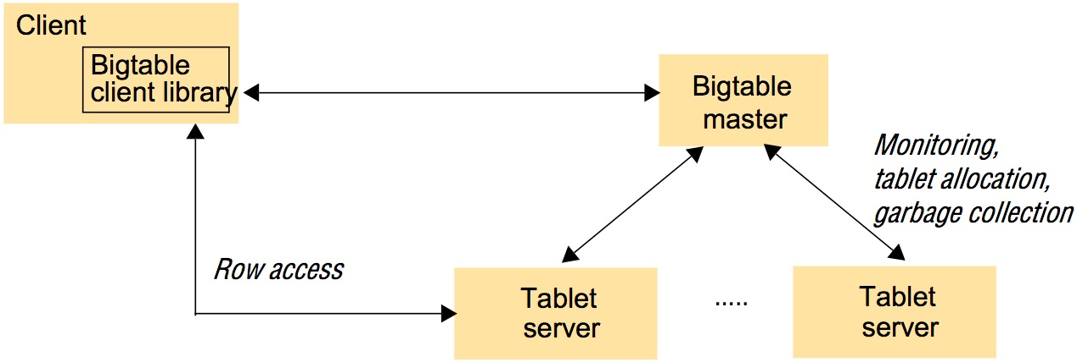
Overall architecture of Bigtable
A Bigtable is broken up into tablets, with a given tablet being approximately 100 to 200 megabytes in size. It use both GFS and Chubby for data storage and distributed coordination.
Three major components:
A library component on the client side
A master server
A potential large number of tablet servers

Slide 19
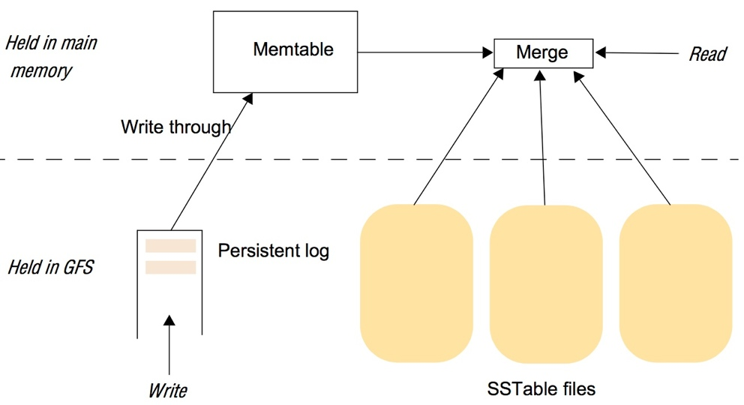
The storage architecture in Bigtable

Slide 20
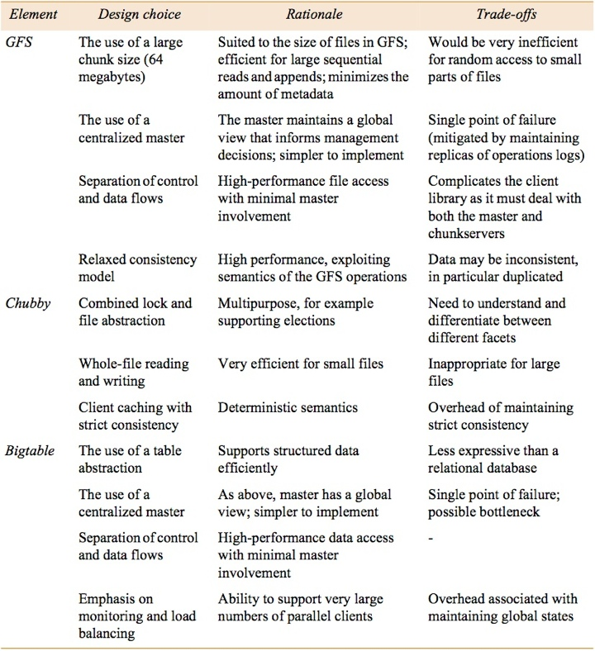
Summary of design choices related to data storage and coordination

Slide 21
Distributed Computation Services
The Google infrastructure supports distributed computation through MapReduce service and also the higher level Sawzall language.
MapReduce
Google reimplemented the main production indexing system in 2003 and reduced the number of lines of C++ code in MapReduce from 3,800 to 700, a significant reduction, albeit in a relatively small system.

Slide 22
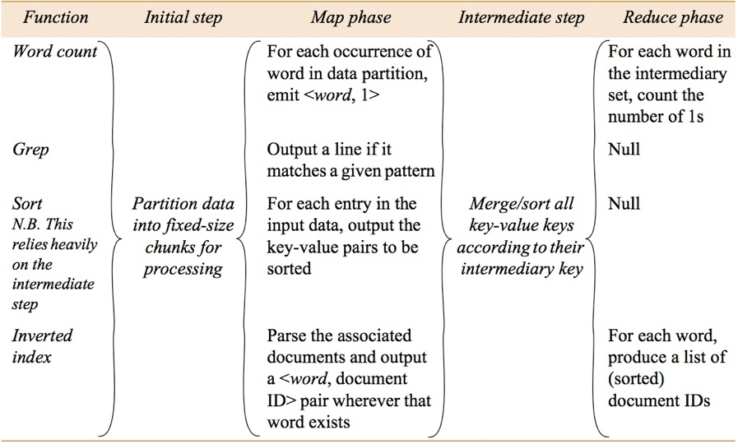
Examples of the use of MapReduce

Slide 23
References
George F. Coulouris and Jean Dollimore. 2012. Distributed Systems: Concepts and Design. Addison-Wesley Longman Publishing Co., Inc., Boston, MA, USA.

